Slide 1
Satellite for smart cities with the application of IoT based smart healthcare
Elham Honarvar
June 2021

Slide 2
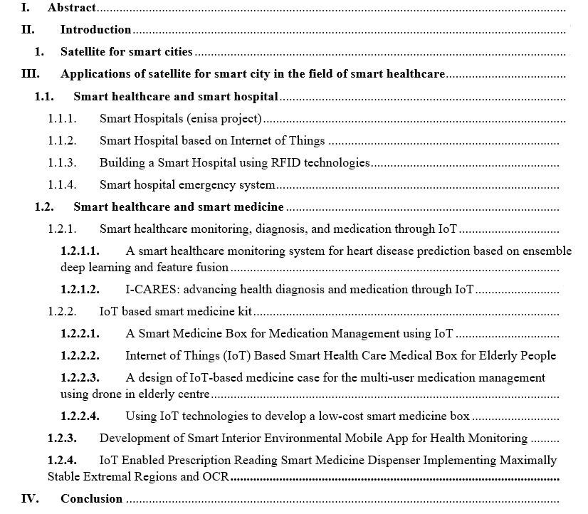
Contents

Slide 3

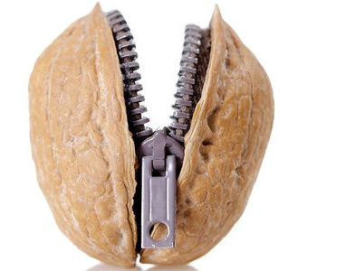

abstract
Internet of Things and cloud computing brought new technologies all over the world and as a result the concept of “smart city” has introduced and grown rapidly in recent years. The concept of the Internet of Things (IoT) integrated with embedded system and new technologies in the healthcare sector has opened a new field of research.
Smart healthcare employs a new generation of information technology, such as the internet of things, big data, cloud computing, and artificial intelligence, to completely reinvent the conventional medical system, making it more efficient and personalized. In this research two main categories regarding smart healthcare is analyzed which are smart medicine and smart hospital.

Slide 4
introduction

Slide 5
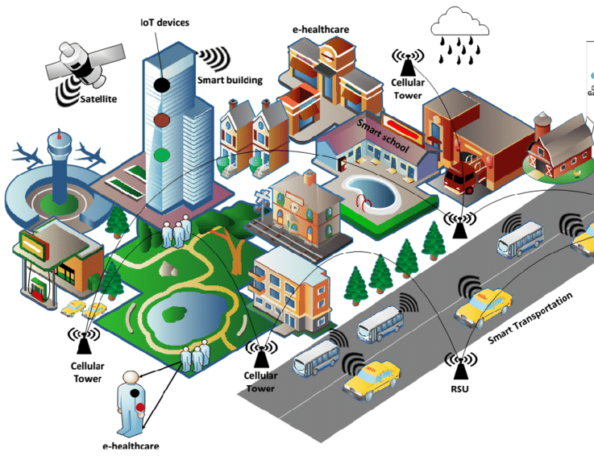
Satellite for smart cities
An IoT-based city that using sensors, actuators and other Communication technologies by transmitting data across different devices is known as smart city.
The IoT is a network of many physical connected devices, like vehicles or home appliances, that enable these ‘things’ to connect and exchange data thus transforming the traditional urban life elements to next generation intelligent systems hence enabling smart cities.

Slide 6
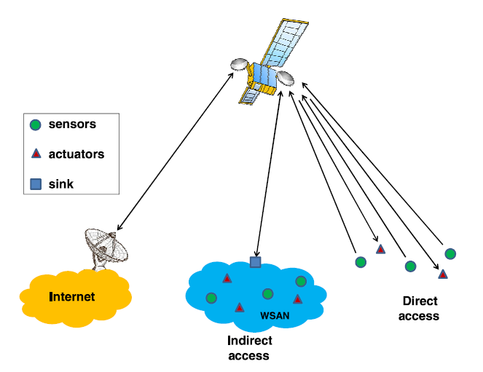
Satellite communication
In several applications, sensors and actuators are deployed in remote areas that are not served by terrestrial access networks; as a result, the use of satellite communication systems for the Internet of Remote Things becomes essential (IoRT).
The satellite collects data measurements from sensor nodes and sends them to a ground station for data management. Moreover, ground stations send control data to satellite which is then send to the actuator nodes as shown in this Figure.

Slide 7
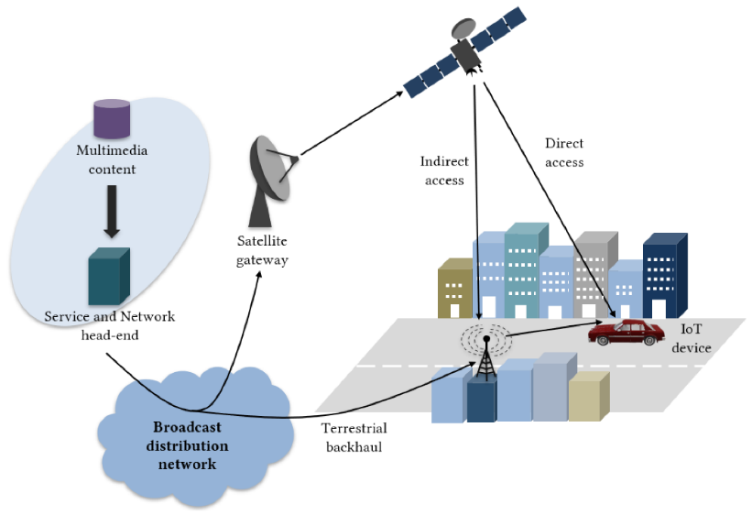
Integrated terrestrial-satellite network architecture
To ensure coverage in satellite-based Internet of Things, a combination of satellite direct reception and terrestrial 5G infrastructure is required, especially in smart cities where buildings can cause high power losses. With improved bandwidth and higher consumer data speeds than today's capabilities, 5G networks are supposed to offer access to everyone, anywhere, at any time. The review of the ongoing 5G specification indicates two key alternatives for the satellite radio access network (RAN) in the potential 5G architecture, according to the European Commission’s Horizon 2020 project “SaT5G” :
Remote access: Via a satellite connection, user equipment has direct access to the 5G network.
Indirect access: user connects to a RAN via a satellite connection that is linked to the 5G core

Slide 8
Iot-based smart city applications
IoT-based smart city applications can be grouped into enterprises, personal and home, utilities and mobile.
Personal and home applications include e-healthcare services which help a doctor to monitor patients remotely or more widely smart hospital, a highly immersive world filled with high-tech gadgets.
Mobile applications include intelligent transportation system (ITS). Autonomous cars will receive updated information through monitoring and address assignment, avoiding traffic and accidents.
Another important application is regarding Electric Vehicles (EVs) charging paradigm. By utilizing the advantages of the Internet of Things (IoT) technology, it is possible to provide a better EV charging system.

Slide 9

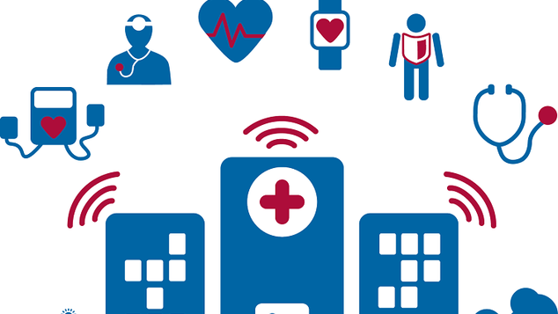
Applications of satellite for smart city in the field of smart HOSPITAL

Slide 10
SMART HEALTHCARE AND SMART HOSPITAL
Connected medical devices are changing how the healthcare industry operates within hospitals. When connected to clinical information systems, connected medical devices will improve patient safety and performance. When this is applied to the whole healthcare ecosystem, it is referred to as a "Smart Hospital."
The most recent research in this field includes:
Smart Hospitals (enisa project)
Smart Hospital based on Internet of Things
Smart Hospital emergency system
Building a smart hospital using RFID technology

Slide 11
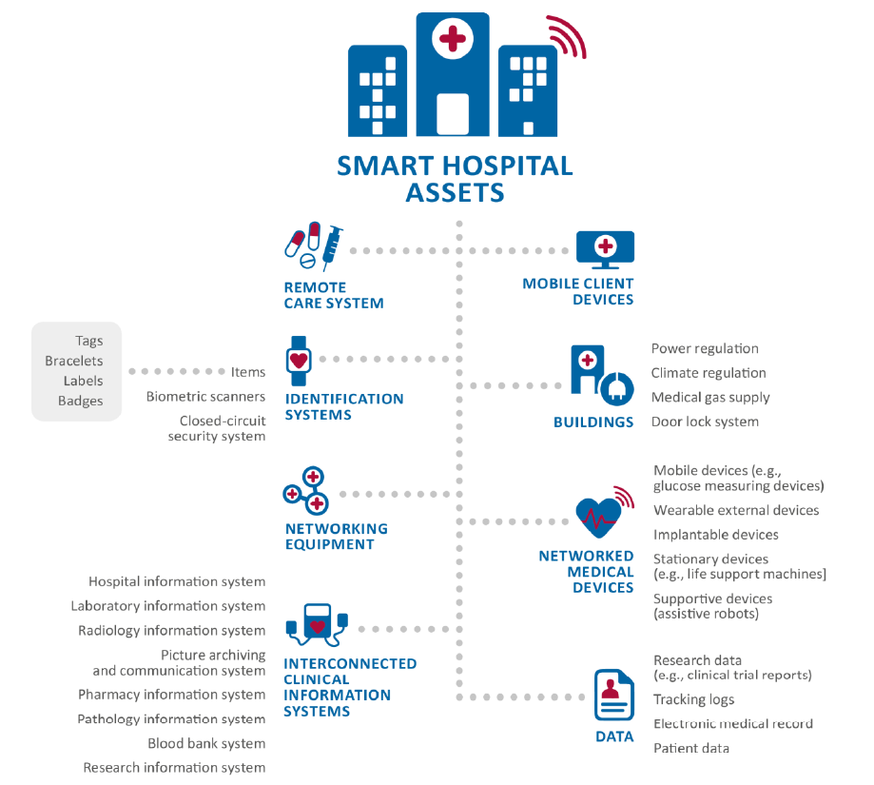
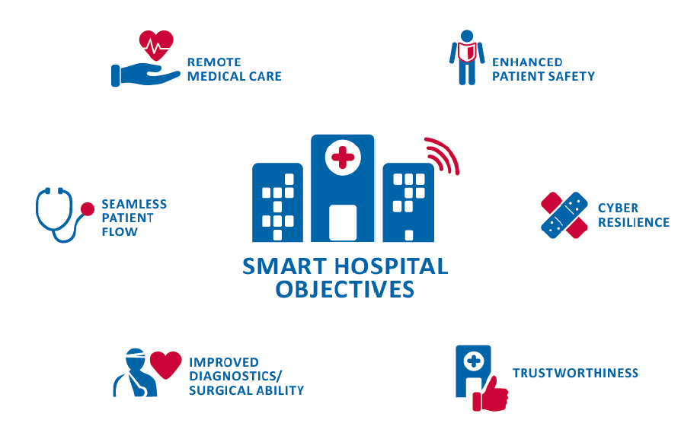
Smart hospital (enisa project)
A smart hospital relies on optimized and automated processes built on an ICT environment of interconnected assets, especially based on Internet of things (IoT). The objectives of a smart hospital and its assets is shown in following figures:

Slide 12
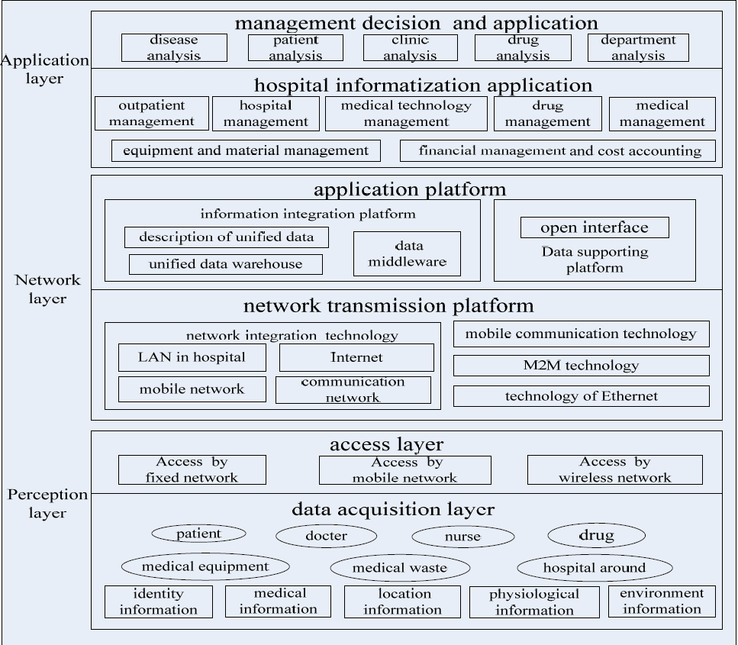
Smart hospital based on internet of things
Experiment shows that deploying a smart hospital have a significant impact on the current diagnosis and treatment mode. The popularity and partial use of HIS (patient information system) has helped the hospital achieve a certain level of informatization. Some Key technologies of IoT includes:
Internet Technology
RFID Technology
Sensor Network Technology
Wireless Communication Technology
Embedded Technology
The architecture of smart hospital is shown in the picture.

Slide 13
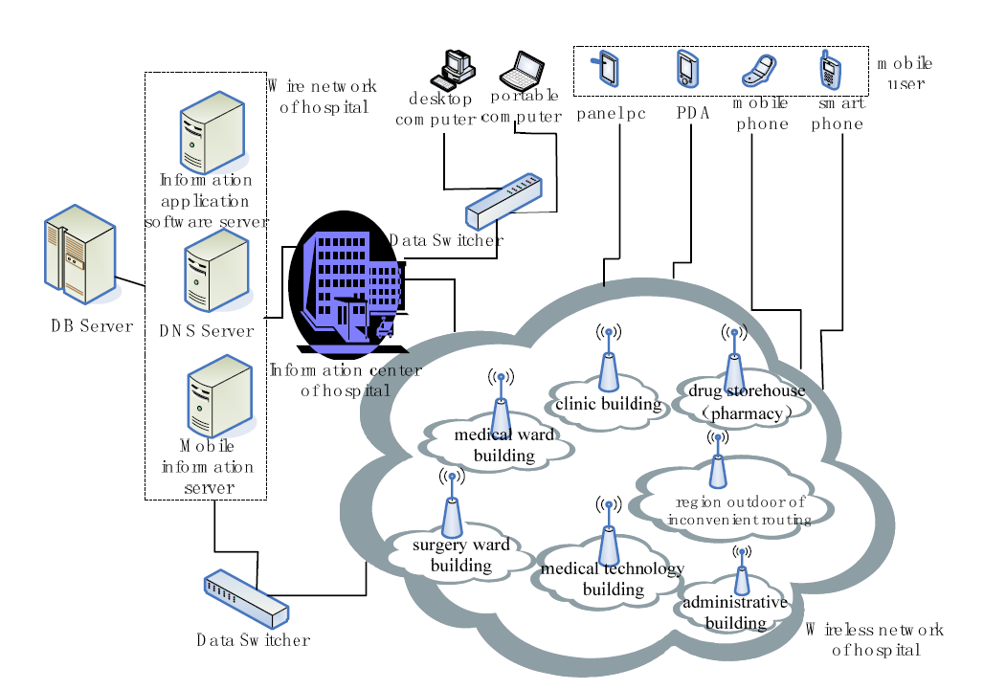
Smart hospital based on internet of things

Slide 14
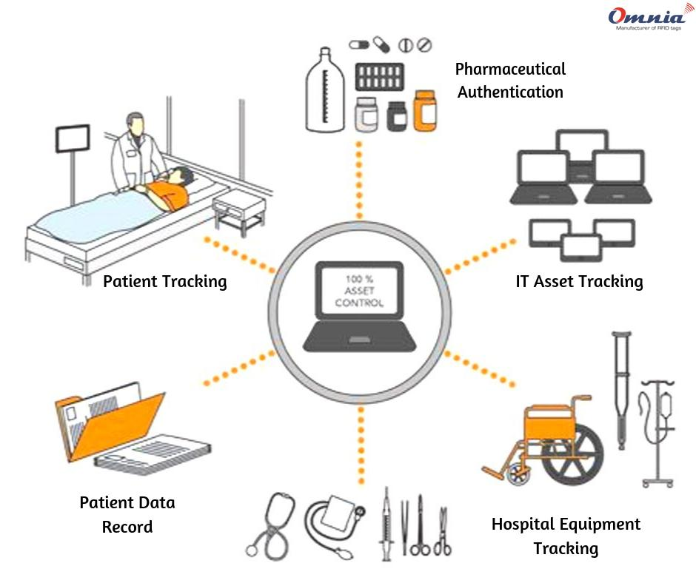
Building a smart hospital using rfid technologies
RFID (Radio Frequency Identification) is a technique for remotely storing and retrieving data via RFID tags or transponders. An RFID tag is a small object that can be applied to or inserted into a product, such as an adhesive sticker. Many of the facilities' properties and performers must be "tagged":
RFID tags must be embedded in medical equipment.
Physicians, nurses, caregivers, and other employees wear a "smart badge" with their employee ID number stored on it.
Each patient is given a wristband with an embedded RFID tag that contains a unique identifier as well as some personal information.
Self-adhesive RFID labels with a specific number are attached to all of the patients' medical records and other relevant documents.
RFID stickers can be seen on blister packs and other drug packets.
A self-adhesive RFID label with a unique identifier, the hospital tracking code, and some relevant details about the contained type of blood is attached to the blood bags.
RFID readers are also strategically located in the hospital.
Some of the use Cases in a Smart Hospital: It provides the most up-to-date information on RFID technologies used in healthcare applications.
Patient Identification
Blood Tracking

Slide 15
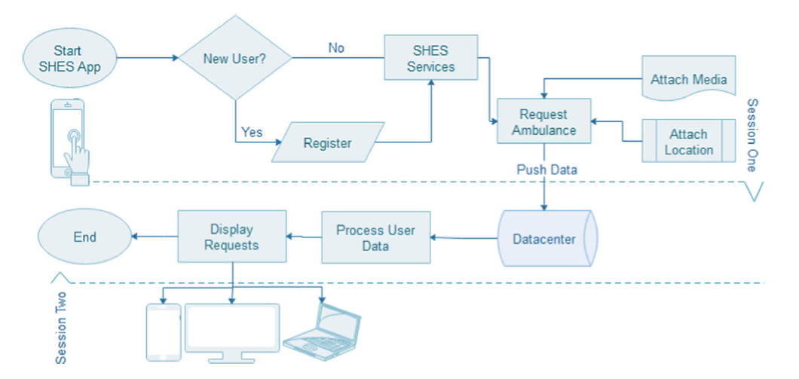
Smart hospital emergency system
A new framework called Smart Hospital Emergency System is suggested in this paper (SHES).SHES key goal is to save lives by enhancing contact between patients and emergency responders. SHES aims to improve emergency communication throughput while reducing emergency call system problems and making the emergency response process more effective by using the latest technology and algorithms.
The flowchart depicts the method of requesting an ambulance, in which the SHES application first determines whether the patient is a first-time user or not. If this is a first-time user, registration is required. Additionally, since users' mobile locations can be traced, this may aid in the prevention of malicious requests. As a result, all of this information is sent over the internet(5G,4G or Wi-Fi) to data centers, where it is processed and made available for use/access by approved healthcare providers.
Finally, to view patient requests, a web-platform is linked to the data center.

Slide 16
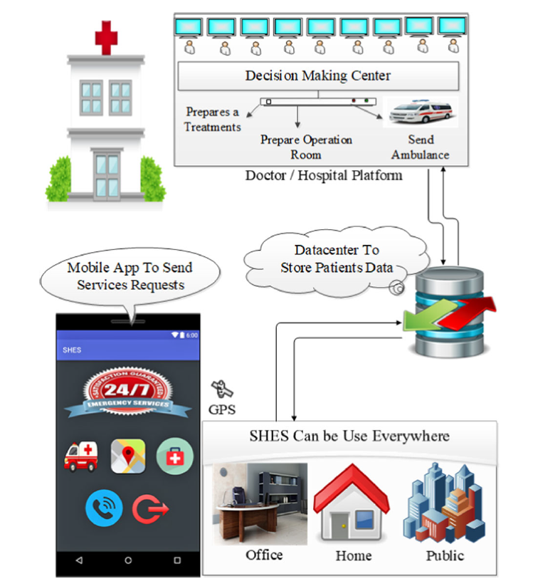
Smart hospital emergency system
SHES is a mobile-based program that connects to the hospital network (i.e., the emergency and injury unit) and responds to patient inquiries as well as requests for ambulance services. The app can mostly be used for one of two purposes: either to order an ambulance in an emergency or to keep track of a patient's symptoms on a daily basis (such as blood pressure, heart-rate and etc.). The SHES architecture is depicted in following Figure.

Slide 17
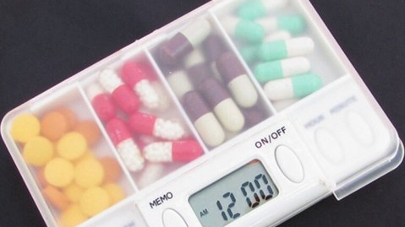
Applications of satellite for smart city in the field of smart MEDICINE

Slide 18
SMART HEALTHCARE AND SMART medicine
Elderly people have had a drug intake problem for a long time because they either do not pay attention to or fail to take their medications on time. Furthermore, there have been instances where patients have made prescription errors, such as taking the incorrect medication. As a result, the idea of proposing a smart medical or smart medicine has emerged. The principle of smart medicine has been used in a variety of applications. The most recent applications have been covered and explained in depth in this study.
Smart healthcare monitoring, diagnosis and medication through IoT
IoT based smart medicine kit
IoT enabled prescription reading smart medicine dispenser implementing maximally stable extermal regions and OCR
Development of smart interior environmental mobile app for health monitoring

Slide 19
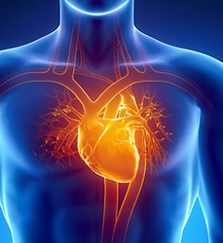
SMART HEALTHCARE MONITORING,DIAGNOSIS, AND MEDICATION THROUGH IoT
It is important to reliably predict heart disease in order to treat cardiac patients efficiently before they have a heart attack, which can be done with the help of an optimal machine learning model and reliable healthcare data on heart diseases. In this part two researches in the field of healthcare monitoring, diagnosis is discussed.
A smart healthcare monitoring system for heart disease prediction based on ensemble deep learning and feature fusion.
I-CARES: advancing health diagnosis and medication through IoT

Slide 20
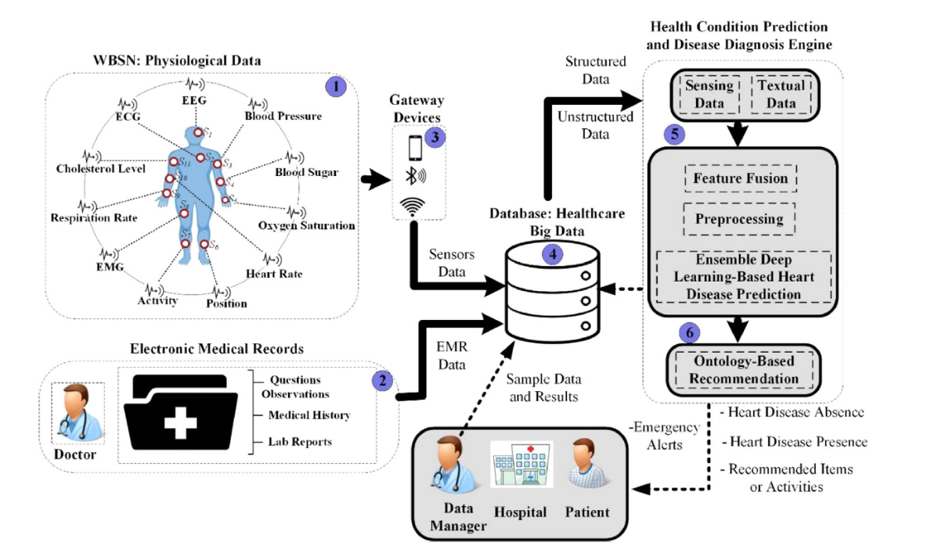
SMART HEALTHCARE MONITORING SYSTEM (SHMS) FOR HEART DISEASE PREDICTION BASED ON ENSEMBLE DEEP LEARNING AND FEATURE FUSION
Wearable sensors and EMRs are two important factors in a healthcare monitoring system for heart disease patients. In recent years, many systems which used wearable sensors to improve the process of heart disease prediction is proposed but most of them failed in efficient feature extraction and feature weighting approach. HealthFog system was presented to automatically treat heart patients using Internet of Things (IoT) devices and a deep learning model. The main aim of it is to control the heart patient data coming from the IoT devices. The structure of the smart healthcare monitoring system for heart disease prediction is illustrated in following figure.

Slide 21
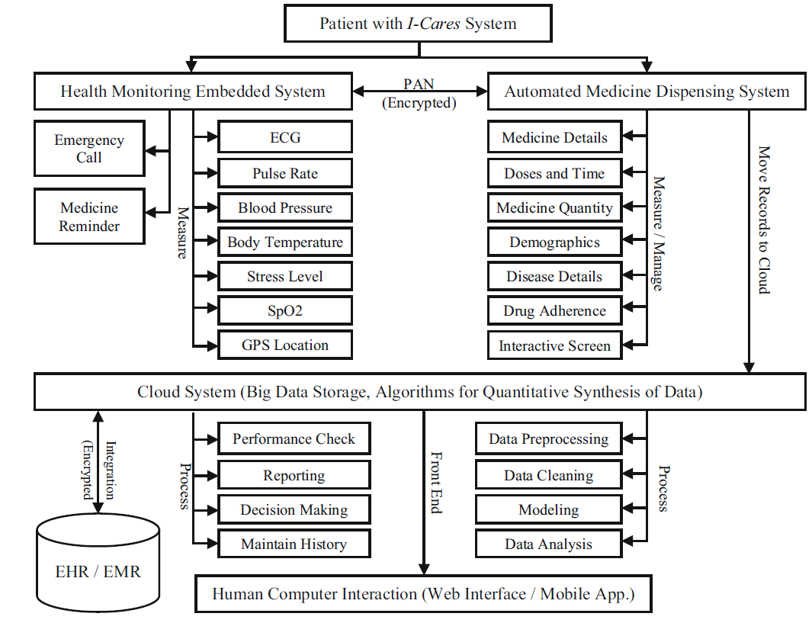
i-cares: ADVANCING HEALTH DIAGNOSIS AND MEDICATION THROUGH IOT
In this paper, an IoT prototype of a Wireless Sensor Network and Cloud-based system is developed with the goal of providing continuous monitoring of a patient's health status, ensuring timely scheduled and unscheduled medicinal dosage based on real-time patient vitals measurement, and predicting and communicating life-saving emergencies. A wearable health tracking system, Smart Medicine Dispensing System, Cloud-based Big Data analytical diagnostic, and Artificial Intelligence (AI) based reporting platform make up the planned integrated prototype.
I-CARES use two methods for contacting emergency personal which are integrate one with Internet communication and other through text when internet is not available. The I-CARES architecture is shown in the Figure which consists of a health monitoring system with sensors that can measure vital signs including but not limited to Electrocardiography (ECG), pulse rate, blood pressure, body temperature, stress level, sweating, and peripheral capillary oxygen saturation (SpO2).
The monitoring system sends the information to the Smart Medicine dispenser, which in turn sends the information to the cloud using Wi-Fi. This system can also communicate with monitoring system to send alarms to the patient to remind him/her of the scheduled and out of schedule medicine dosages.

Slide 22
Iot-based smart medicine kit
Many attempts have been made in recent days to design a "Medicine Box" that would assist people with prescription reminders, storing their medicine uptake information, and providing appropriate temperature conditions for storage. Some of the suggested methods are discussed in this section.
A design of IoT-based medicine case for the multi-user medication management using drone in elderly centre
Internet of Things (IoT) Based Smart Health Care Medical Box for Elderly People
IoT Enabled prescription reading smart medicine dispenser implementing maximally stable extermal regions and OCR
A Smart Medicine Box for Medication Management using IoT
Using IoT technologies to develop a low-cost smart medicine box

Slide 23
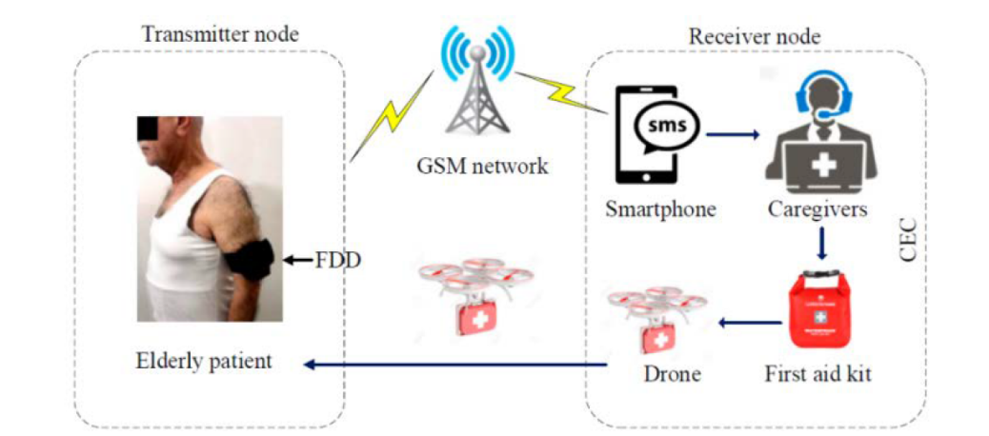
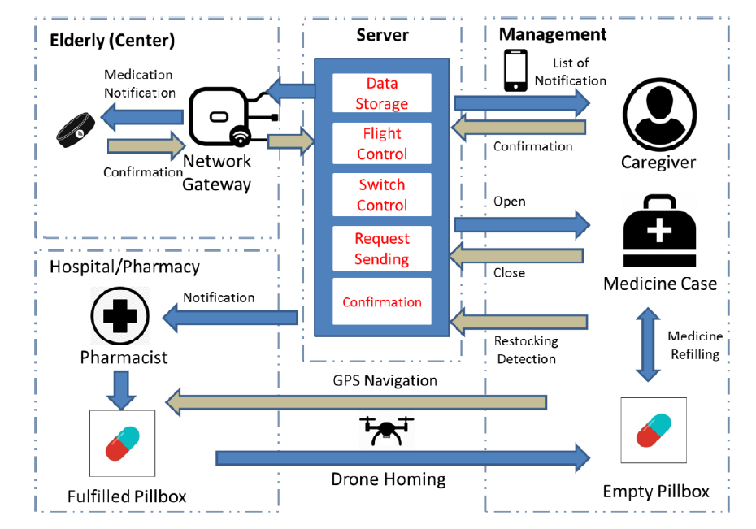
A design of iot-based medicine case for the multi-user medication management using drone in elderly centre
The aim of this study is to design and build a Medication Management System (MMS) that will control medication management and automate medicine delivery using an unmanned aerial vehicle (UAV) for system automation and self-sufficiency in an elderly center.
The majority of smart medicine reminder device designs are geared toward scheduling a single user-based medicine intake arrangement. The proposed scheme, in comparison to other systems, is intended to assist caregivers in managing multi-elderly drug control and reducing the risk of medication-intake incidents. Furthermore, since the drone is part of our system, it is used to retrieve medicines from a hospital or pharmacy using a pre-programmed navigation path. The MMS system is depicted in the following figure.

Slide 24
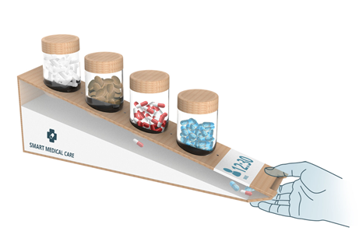
Iot based smart healthcare medical box for elderly people
The intelligent medicine box in this project will assist a patient by reminding him or her when it is time to take his or her medication.
The box would alert patient to take medicine by making a sound and sending an alarm. If he forgets when to take medication , the medicine box will not open because it is locked by a servo motor.
When it's time to take the medication, the package will make a noise and send a warning before the user takes the medicine or opens the drawer.
In addition, if the user is away from home, the medicine box can use the Wi-Fi module to send an email notification to the user's specified email address.
The device also includes a temperature sensor to control the user's temperature, as temperature is an important factor to consider when monitoring a patient's health.
The temperature and medication data will be stored on a server that both the patient and the doctor can access, so that when it is time, the doctor can check the medicine and make any necessary changes.

Slide 25
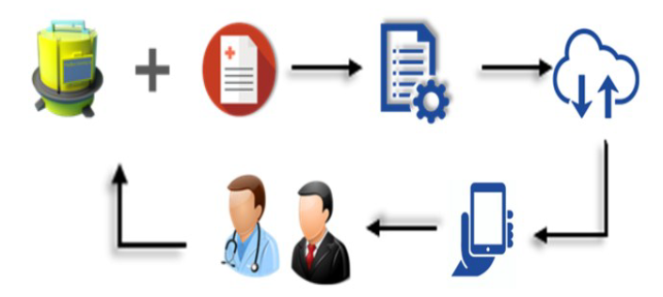
IOT ENABLED PRESCRIPTION READING SMART MEDICINE DISPENSER IMPLEMENTING MAXIMALLY STABLE EXTERMAL REGIONS AND OCR
In this study, we proposed an IoT-powered smart medication box with a camera for scanning the prescription. After the computer scans the drug with the camera, it is subjected to a variety of preprocessing techniques to extract additional information. The method of Maximally Stable Extremal Regions was then used (MSER). Before being uploaded to the database, the extracted text is subjected to string manipulation. The data is then used by our medicine box to warn the patient via buzzer and show medication information on the LCD display. Finally, the medicine box dispenses individual drugs and records the use period in the database. If the dispenser runs out of medication, our system will show a message on the monitor to alert the patient.

Slide 26
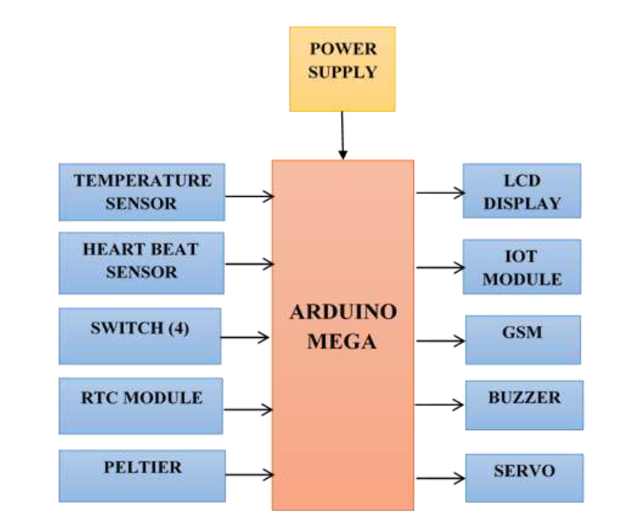
A Smart Medicine Box for Medication Management using IoT
This project aids in the tracking of a patient's vital parameters in order to minimize the number of times a patient sees a clinician. The critical parameters are stored in a cloud server designed specifically for clinician analysis, along with the Host Management System (HMS). As a result, this project of an adequate temperature storage box for medicine enables elderly patients to live independently by providing a reminder alarm and automated wireless health switch. This Figure shows the architecture consists of both hardware and software modules.

Slide 27
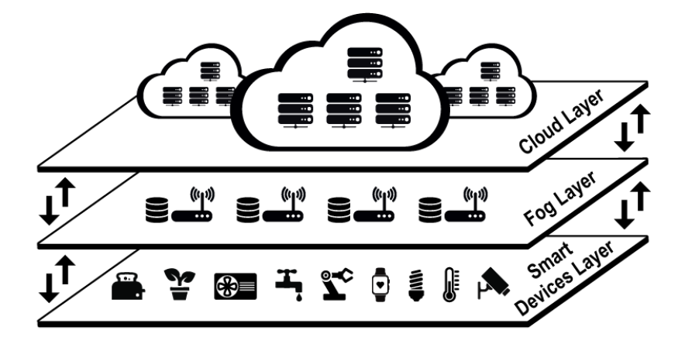
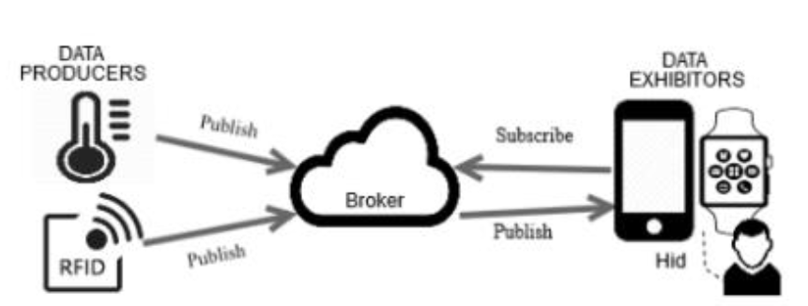
Using iot technologies to develop a low-cost medicine box
This research proposes the development of a low-cost smart medicine box prototype that will alert users to take their medications on time, according to the schedule previously set on the user interface. The idea of edge computing was used to create a solid architecture that addressed scalability, efficiency, interoperability, and security, among other things. This prototype is a limited-scope initial solution that will be used as a proof of concept.

Slide 28


CONCLUSION

Slide 29
CONCLUSION
An intelligent network of connected objects and machines (also known as a digital city) that transfer data using wireless technology and the cloud is a major part of this ICT architecture. Real-time data is received, analyzed, and managed by cloud-based IoT applications to assist municipalities, businesses, and residents in making informed decisions that enhance quality of life. The satellite industry, without a question, is one of the fastest-growing sectors in Smart Cities, owing to the high level of connectivity they require. Smart buildings, traffic management, parking spaces, street lights, and even smarter networks would all benefit from it.
When IoT technical innovation is applied to one of the most conventional vital industries, healthcare, the outcomes are outstanding. In conclusion, smart healthcare has a bright future. Individual users can benefit from smart healthcare because it allows them to better control their own health.
In terms of smart mobility, AVs are causing a shift in the transportation business model due to their characteristics. Satellites would aid in the safe and efficient transportation of the populace. Autonomous cars would receive current information via monitoring and address assignment, avoiding traffic or an accident in road.
Regarding another application of IoT-based smart city which is EV charging stations what is concluded is that, with IoT technology, EV charging stations become more efficient and convenient not only for drivers, but also for service workers. By applying IoT, EV stations can be easily monitored and managed within one platform.

Slide 30


Thank you

